Slide 1




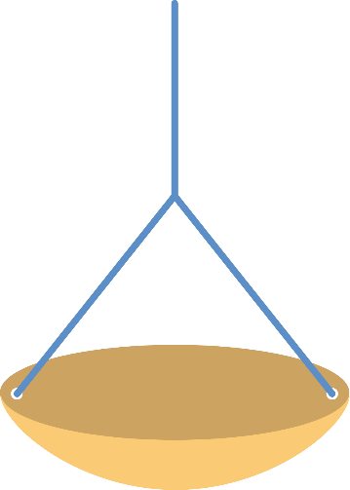

두 가지 물건의 무게를 비교해 보세요.
#2
#3
#6
#5
#4
#7
Notes:
(narration plays) “두 가지 물건의 무게를 비교해 보세요.” (reading the question sentence) [soundtrack: M3-16-1-1-s001]
#3 arrow blinking until users touch #2 image
once users drag #2 to #4 basket. #3 arrow fades out (disappears) and the left part of the scale goes down.
now #6 arrow is blinking until users touch #5 image
when users drag #5 to #7 basket, #6 arrow fades out (disappears) and the right part of the scale goes down.
conclusion narration plays ** blinking effects according to the narration.
(narration plays) 양팔 저울에서는 내려간 쪽이 더 무겁습니다. [soundtrack: M3-16-1-1-s002]
“사과”는 올라가 있으므로 더 가볍고, (-> the apple (#2) on the basket(#4) is blinking twice) [soundtrack: [soundtrack: M3-16-1-1-s003]
“수박”은 내려가 있으므로 더 무겁습니다. (-> the watermelon (#5) on the basket (#7) is blinking twice) [soundtrack: [soundtrack: M3-16-1-1-s004]

